Slide 1
Documentation for ‘fire emblem game’
OOP Project 2017/2018
Members:
Corentin Ferrier,
Michiel Ocula
Dilini Pallewasalage Don Perera
Lorenzo Conca

Slide 2

Installation
Requirements:
Installation of Pharo 6.0 or latest version
Load Bloc element by running this on the Playground:

Slide 3
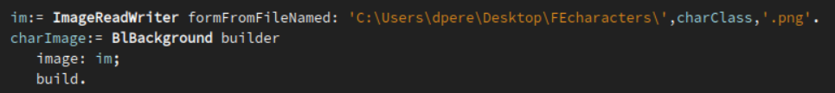
Download the .mcz file from GitLab or GitHub
Load the .mcz file in the Pharo system and open the package
Download the images of every character
(Archer.png ; King.png ; Knight.png ; Magician.png ; Skeleton.png and Soldier.png)
Change the path in : FireEmblem Package >> FETileElement >> printTile

Slide 4
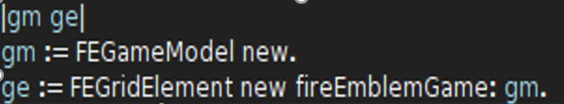
Open the playground and run:
Use the live pannel to play

Slide 5
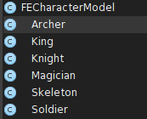
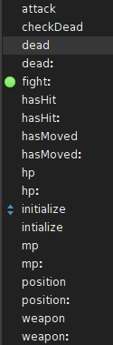
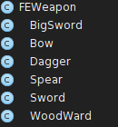

Architecture of our solution and architectural decision
CHARACTER AND WEAPON MODEL:
For the architectural part, we created the FECharaterModel,
where we stored the caracteristics of every
single Character inside the game: if he is dead, if he fights, movement points, health points and which weapon it uses. A weapon is created in the FEWeapon class. In this class we initialized the range of the weapon and the damage that will inflict during an attack.

Slide 6
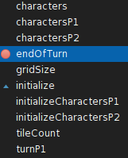
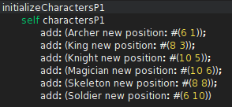
GAME MODEL
In the FEGameModel there is the initialization of the character’s position for the first and second player. There is the size of the grid where there will put every single character.
endOfTurn is a function inside the game model, that is called when the player that is moving or attacking will click on the button ‘End Turn’. The next player will start to play until he clicks on the same button.
The ‘Initialize’ function creates a new ordered collection with every single character, one will be for the first player’s characters, the other one for the second player’s characters.

Slide 7
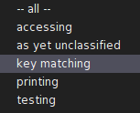
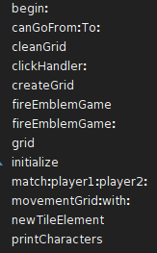
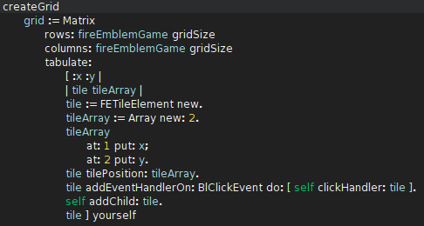
FE GRID element
The FEGridElement is one of the principal classes inside the program. Here we can find the function that will print the characters and the game model in the live window with the function ‘printCharacters’. We can check if a character is allowed to move with the function ‘canGoFrom:To:’. The ‘clickHandler’ handles the click from the mouse in the grid and calls the function ‘match:player1:player2’. The function ‘movementGrid:with:’ colors all the tiles surrounding a particular character depending on his movement points (mp).

Slide 8
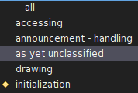
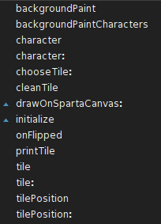
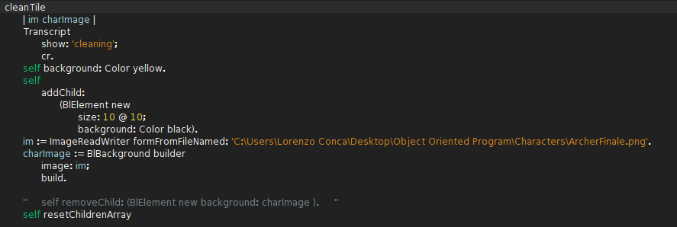
FE tile element
FETileElement is the class that defines the color of every single tile inside the grid, permits to the system to recognize if there is a character inside. The different colors (red and blue) permit the players to select their own characters and to see the position where they could be moved and if they could attack.
‘initialize’ sets the background color and the size of every single tile.
‘cleanTile’ removes the character from the tile after its death.

Slide 9
You can have a look at our video, to see how we implemented the game and how it can be played ! Use the link: https://youtu.be/hnurHQVl0xg

